Slide 1
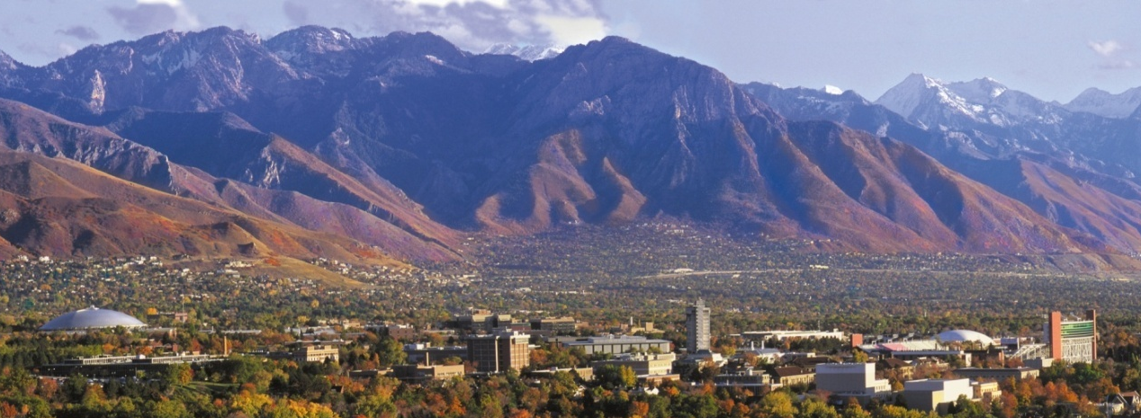
Empolyer Based Trip Reductions University of Utah

Slide 2
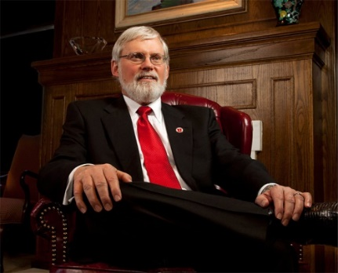
Context: University
Presidential Mission:
…We will build upon our existing commitment to strive for excellence together in all endeavors, embrace equity and diversity, create a sustainable future, and ensure affordable academic and health care programs.
STRATEGIC GOALS
Promote student success to transform lives
Develop and transfer new knowledge
Engage to improve health and quality of life
Ensure long-term viability of the university
OUR CORE VALUES
Student success and engagement
Research and teaching excellence
Diversity
Sustainability
Global vision and strategy
Community
Leadership
Notes:
A transition to the ACUPCC and the role of education in this commitment…
2

Slide 3
Context
ENGAGEMENT
Waste
Air & Climate
Dining
Campus
Water
Purchasing
Buildings
Provide a framework for sustainability
Enable meaningful comparisons
Create incentives for improvement
Facilitate information sharing
Build a stronger, more diverse sustainability community.
Public
Grounds
Energy
Transport
OPERATIONS
Health
Diversity
Invest
Research
Planning
Curriculum
ADMINISTRATION
ACADEMICS

Slide 4
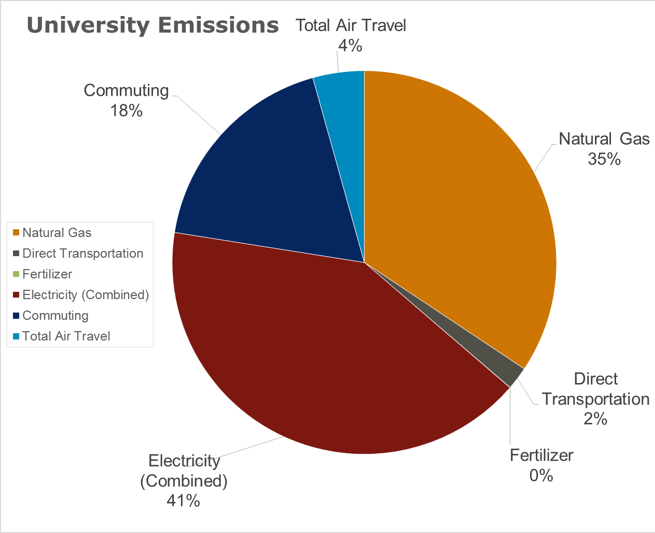
Greenhouse Gas Breakdown 20% transportation

Slide 5
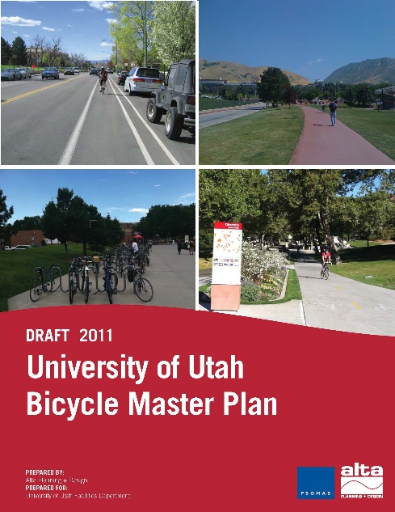
Climate Action Plan
Curriculum, Education and Research
Renewable Energy and Energy Efficiency
Transportation
Solid Waste, Grounds, Water, & Food
Campus Master Plan
Infill Development: …pedestrian friendly campus
Transit Nodes: adjacent to each existing TRAX station
Enhanced Connections: pedestrian and bicycle facilities
Student Engagement: …facilities for campus activities
Bicycle / Pedestrian Plan
Provide safe and accessible routes for bicyclists
Implement education programs
Improve bicycle and transit connections
Create an integrated campus bikeway network

Slide 6
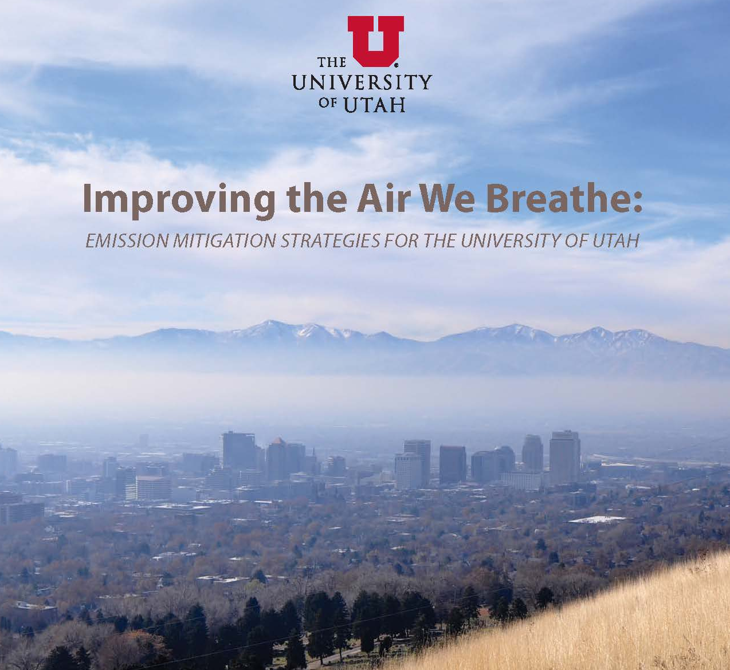
Plan Goals: BMPs for mobile sources
Promote Guaranteed Ride Home with UTA
Develop Clear the Air Winter Challenge
Update University Anti-Idling Policy
Include Anti-Idling Policy in Vendor Contracts
Transit Passes for Visitors to Events (Athletics)
Smoking Vehicle Program
Promote Flexible Schedules and Telecommuting Promote Carpool Technology - Zimride
Transit Standard for R.E. Leases and Purchases
Anti-Idling Signage and Campaign
Enhance Shuttle System Routing on Campus
Fund Active Transportation Infrastructure
Expand Electric Vehicle (EV) Charging
Support Clean Vehicles: Preferred & discount Parking
Implement Parking Rate Increases

Slide 7
Dozens of strategies, including TDM

Slide 8
Progress to date
Community program - ~200 EVs and PHEVs
All-access UTA pass
UTA pass to all ticketed athletic events
Average 35-40% mode share (non-SOV)
+ ~50 alt-fuel vehicles to campus fleet (in 4 years)
68% of students use alternative modes
50% faculty & staff use alternative modes
Active Transportation Manager (in process)
Increased on-campus housing
Website to find housing on UTA routes

Slide 9
Future trends, concerns, questions…
Lack of good quality data
L.O.S. vs other metric
Elasticity (Prices for fuel and parking)
License and ownership trends (Uber/Lyft)
Cycling & walking trends
Ebikes
Air Quality (community health)
Price on carbon? (Mitigation vs. Adaptation)
Community design issues
Self-driving cars
Others?

Slide 10
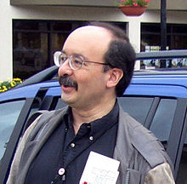
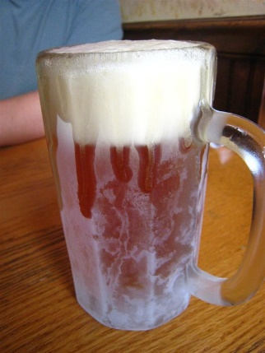
Moving forward
Transport:
System to accommodate “opportunities for exchange”
(PLANNING VS. ENGINEERING)
Utility customers don’t want kilowatt-hours of electricity; they want energy services
Notes:
A transition to the ACUPCC and the role of education in this commitment…
10

Slide 11
Available mechanisms/levers?
Land use
Pricing
Capacity
Marketing & education (behavior change)
Rules & Policies
Programs
Others?
Notes:
Corporate Social Responsibility (CSR) Reports – article in the Guardian based on research from Leeds University… endemic problems (ignoring data from multiple sources)

Slide 12
For political economy purposes, it is important to think not only about policies that reduce the most carbon emissions, but also about policies that create the most constituents for future policies.
Electric car subsidies are hated by economists, loved by activists. Why?
Updated by David Roberts on December 31, 2015, 1:10 p.m. ET @drvox david@vox.com
Notes:
Corporate Social Responsibility (CSR) Reports – article in the Guardian based on research from Leeds University… endemic problems (ignoring data from multiple sources)

Slide 13
Sustainability Action Plan – Transportation
Executive Summary
Plan elements based on/ evaluated by measurable data
Equitable, and address accessibility in broadest terms
Transportation should be easy and enjoyable to use
People-first: should prioritize pedestrians (over SOV travel)
Reduce (ghg) emissions and become carbon-neutral by 2050
50% mode share by 2025
Be a model for what is possible

Slide 14
Sustainability Action Plan – Transportation
Top Strategies
Intermodal Hub(s) with access to services
Active Transportation to be prioritized
Transit improvements: Support BRT, signalization, new routes, transit stop enhancements, clear wayfinding
Shuttle enhancements: inner-campus connections, through-campus routes, on-demand where effective, low-carbon
Help fix Foothill:
Enhance or create pedestrian and bike crossings,
Prioritize BRT and transit,
Create gateway(s) to campus where appropriate.

